Slide 1

KOSS TASK – Teaching Async Await in Python
-Abhinav Prakash

Slide 2

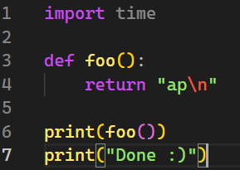
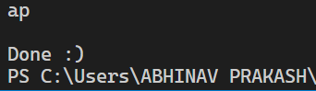
How does standard synchronous coding work?
For any computation we need a processor.
Execution of codes occurs in a sequential manner.
i.e. 1st come 1st serve.
This is something we normally Encounter while doing programming.

Slide 3



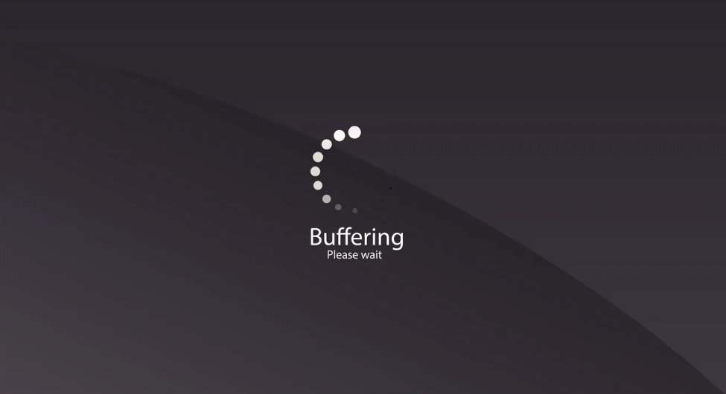

The disadvantages of Synchronous Programming ☹
Execution depends on the time taken by previous codes to execute.
No one likes slow loading/ execution.
Detailed Explanation: Suppose a part of your code requires server access and if the server crash. Then? 😥
Let, your website displays online Photos before showing texts. And due to some reasons, the source from where you used photos is not responding. Then? 😰
Reaction of readers: 😐😑😤😡🤬

Slide 4

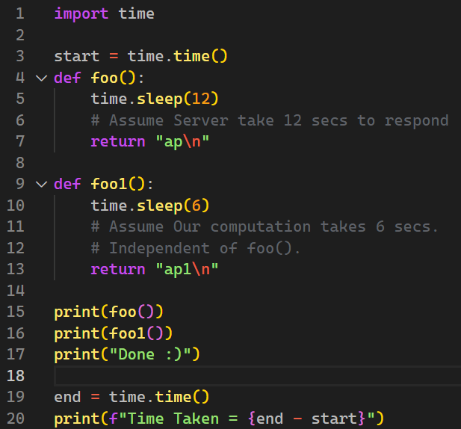
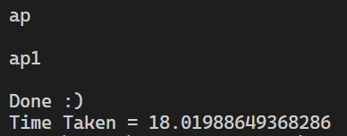
Example of Synchronous flaw
foo() depends on “server response time”.
foo1() is dependent on our code and INDEPENDENT of foo().
But no matter what, foo1() will run after execution of foo()
This is not desirable as users won’t wait that long.
It would be better if foo() keeps on running and in meantime, the program pass execution to foo1().

Slide 5

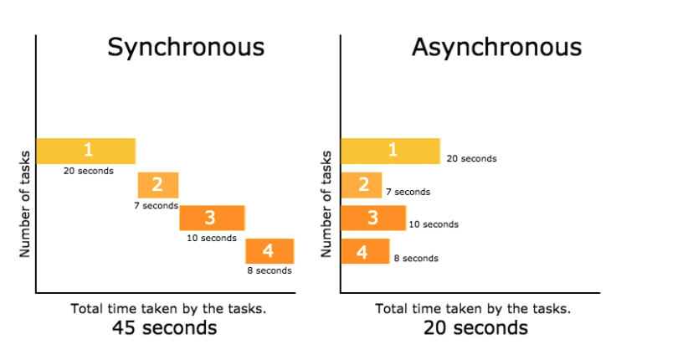
Solution
We can asynchronously run programs.
Helps in using the processor more effectively.
Reduce processing time.
Helps in the better deployment of content.
If there is an issue in some section, then it won’t affect the entire program. i.e. codes after defective section keep on running.😏

Slide 6

Python Async/Await

Slide 7

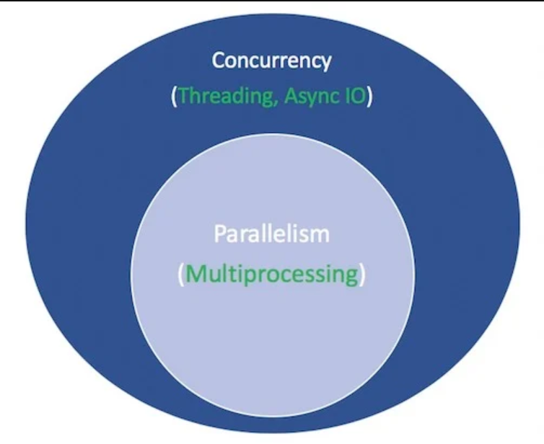
asyncio
It is a Python package that provides a foundation and API for running and managing coroutines.
API - Application Programming Interface, is software that allows two applications to talk to each other.
Coroutines: are used for multitasking where a process gives away control periodically.
Async/Await is found under the asyncio.

Slide 8

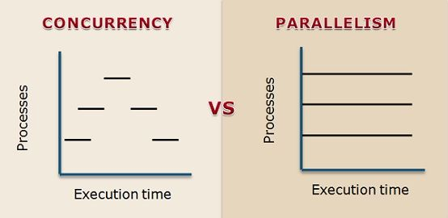
Concurrency V/S Parallelism
Concurrency is the task of running and managing multiple computations at the same time.
(Async/Await + coroutines)
Parallelism is the task of running multiple computations simultaneously.
(ThreadPoolExecutor, ProcessPoolExecutor)

Slide 9
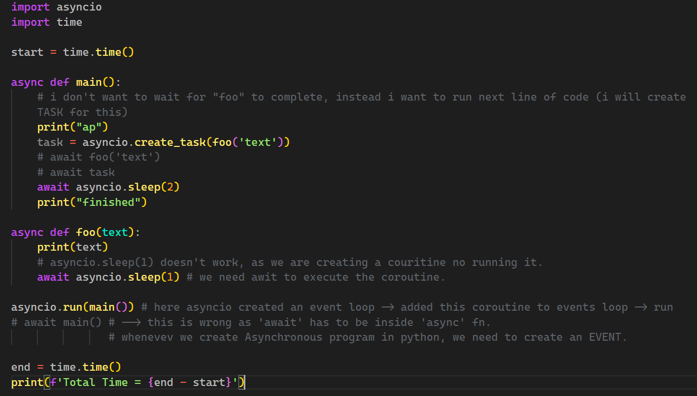
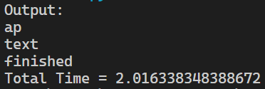
print(“Explanation”)

Slide 10
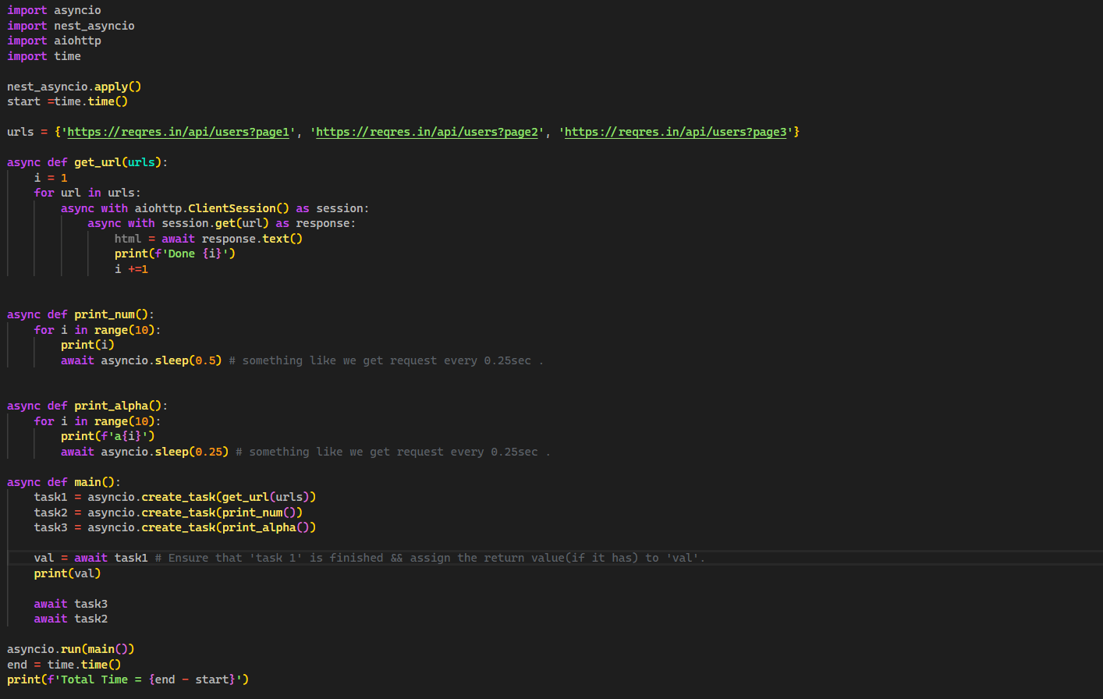
Task - I

Slide 11
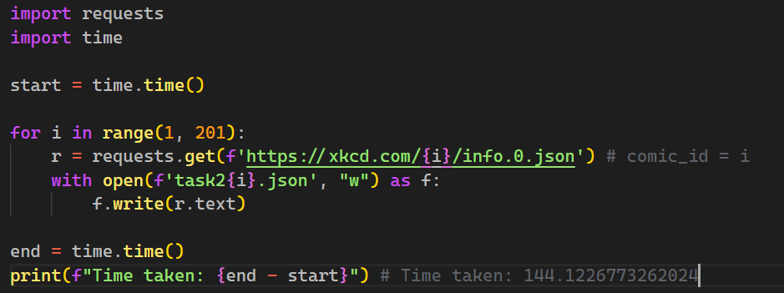
TASK-II Normal Way

Slide 12
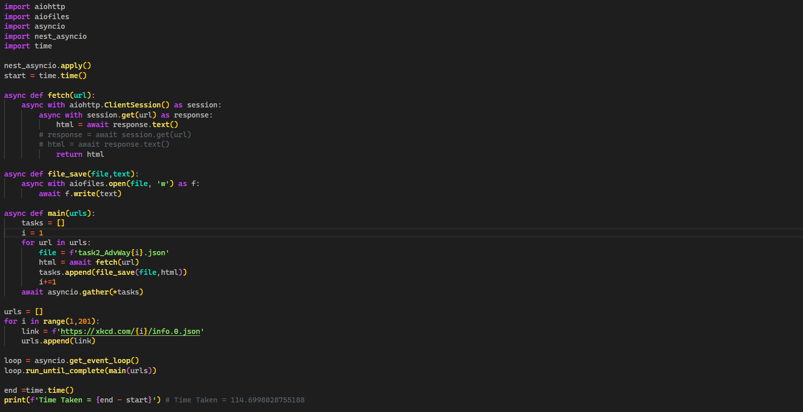
Task - II Adv Way

Slide 13

Python Multiprocessing (ThreadPoolExecutor, ProcessPoolExecutor)

Slide 14

Let’s head to Google Colab for more info.

